Slide 1
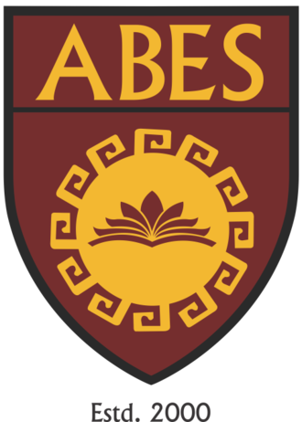
Full Stack Development: FSD
B.Tech 1st Semester
Odd, Session 2025-26
Day-0

Slide 2

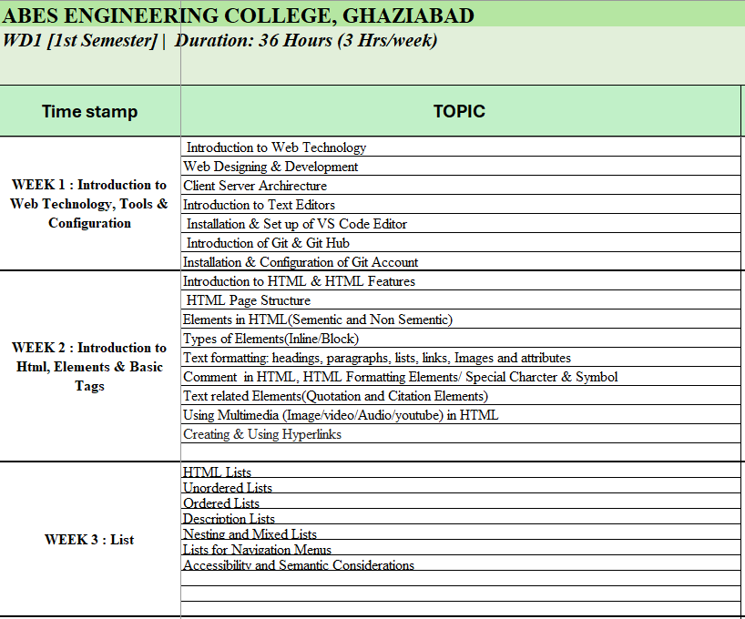
Detailed Syllabus
1st Semester

Slide 3
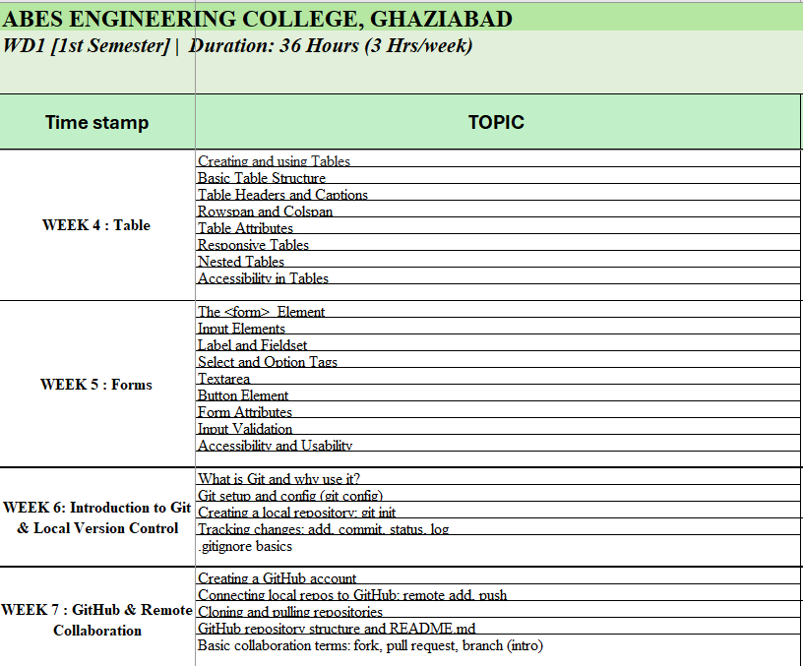
Detailed Syllabus
1st Semester

Slide 4
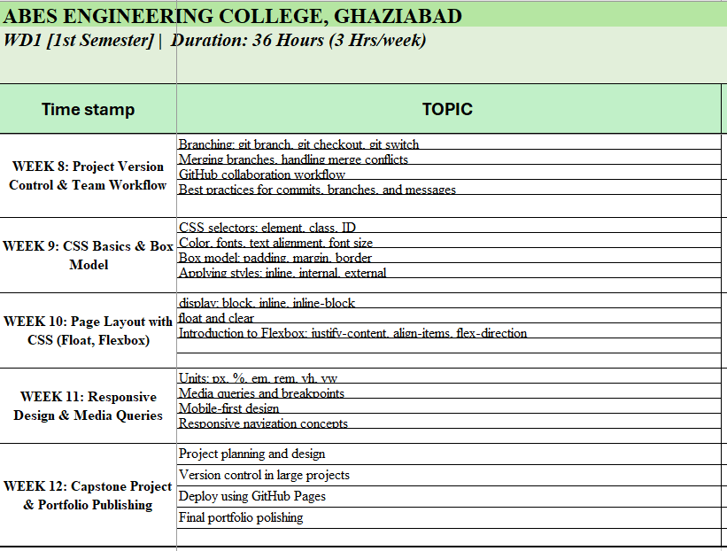
Detailed Syllabus
1st Semester
1. Project will be assigned to each group of students.
2. The final outcome of the contest in one executable project (projects to be uploaded over GitHub)
3. Marks will be assigned through your participation and project development.

Slide 5
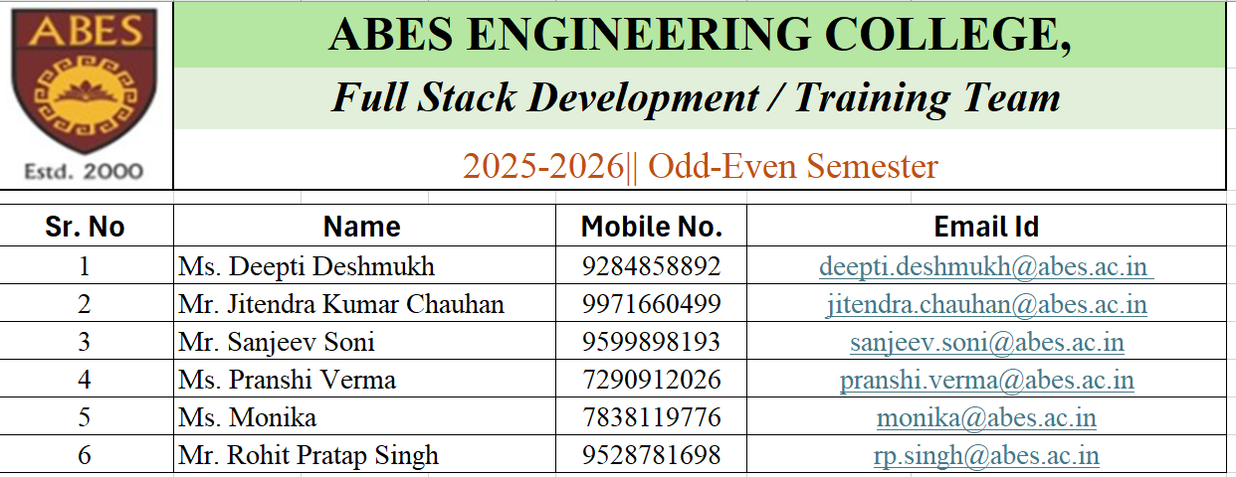
Training Team

Slide 6
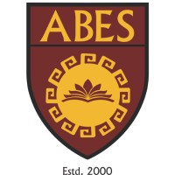

Full Stack Development
Front-End Development
Back-End Development
Database
Rest API
Web Application Architecture
Design Pattern
Version Control System

Slide 7
Full Stack Developer
Over 2 billion Websites
Need for enhanced customer experience
Approximately 5 billion active internet users
In 2024, Full Stack Developers still rank as one of the top roles to be filled, often holding the #1 or #2 spot, closely followed by roles such as AI/ML Engineers and Cloud Engineers.
Among one of the most in demand job profiles for B. Tech Graduates
Ability to work on both frond-end and back-end
Knowledge of a broad spectrum of technologies
Easy to learn
Provides a much wider understanding of the scope of the project
Creative flexibility
Handsome salary packages
The demand for full-stack developers will steadily increase in the market as new technologies emerge.

Slide 8
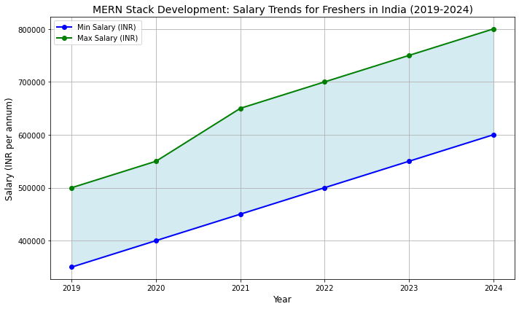
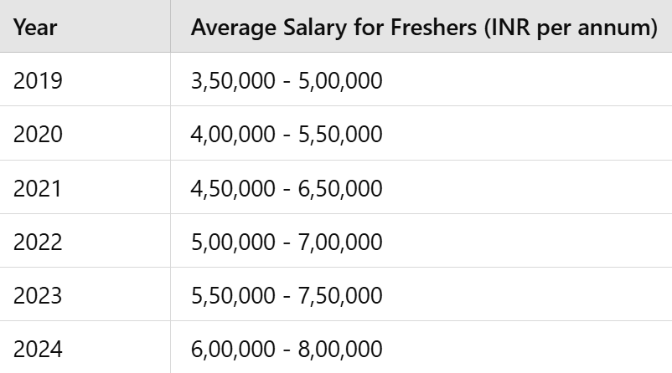
Full Stack Developer (Salary Trends)

Slide 9
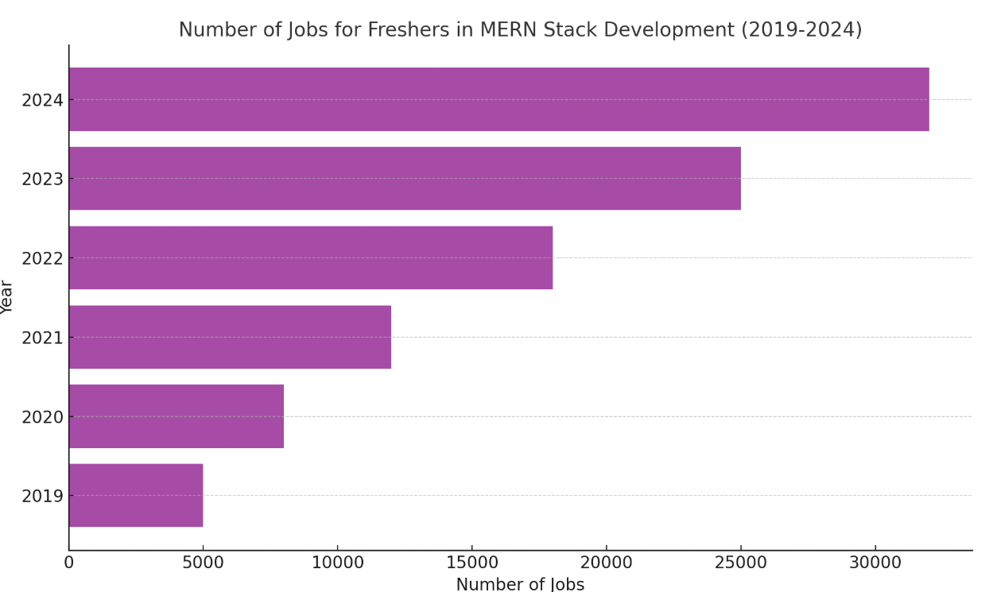
Full Stack Developer (Freshers job Trends)

Slide 10
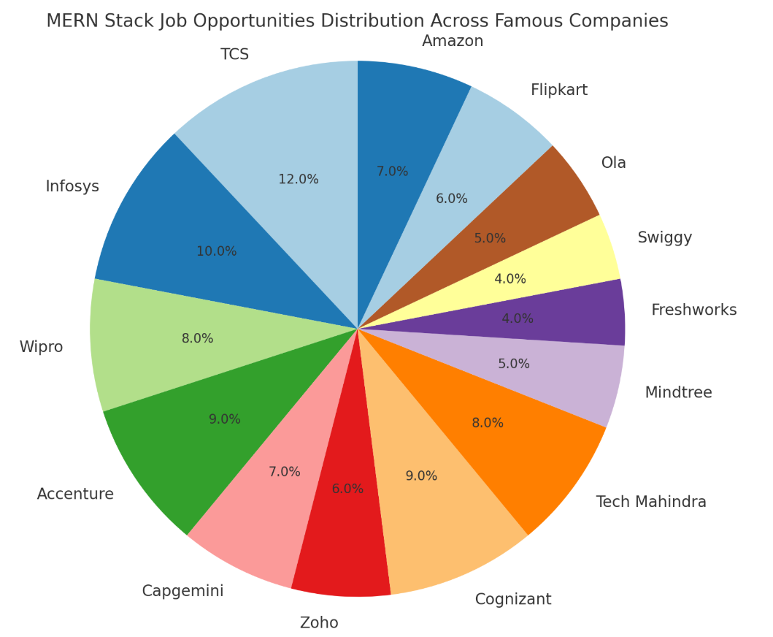
Full Stack Developer (Company wise job Trends)

Slide 11
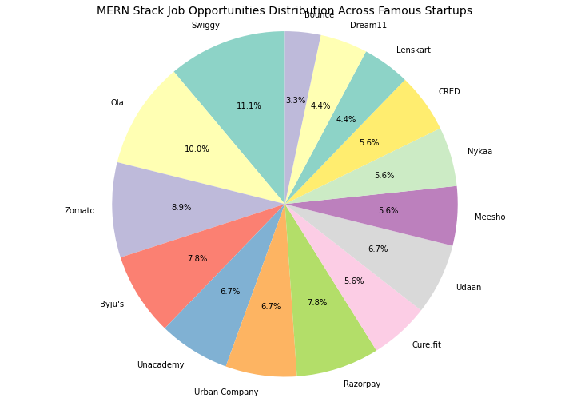
Full Stack Developer (Startups wise job Trends)

Slide 12
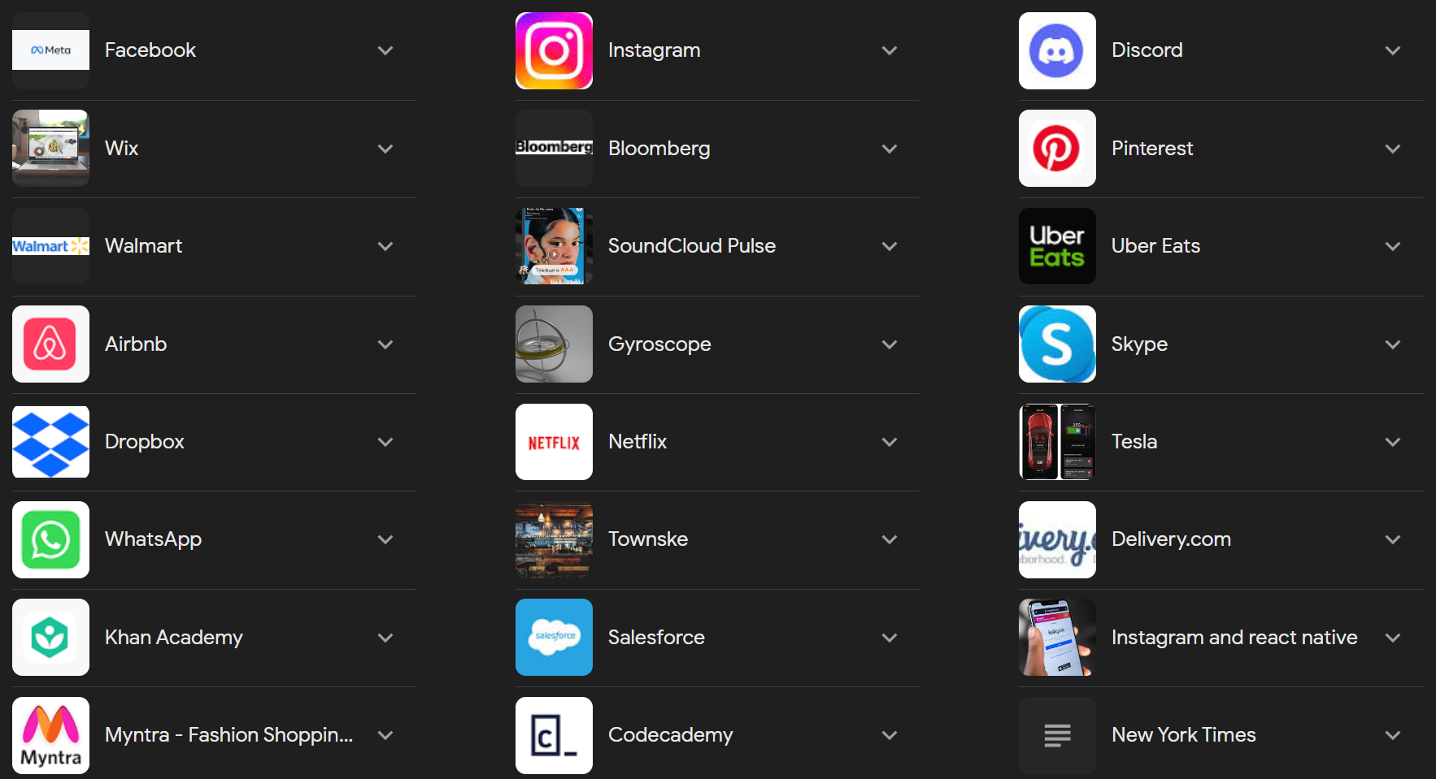
Popular apps built with React
Tempo Bootstrap Template - Index (abesconference.netlify.app)

Slide 13
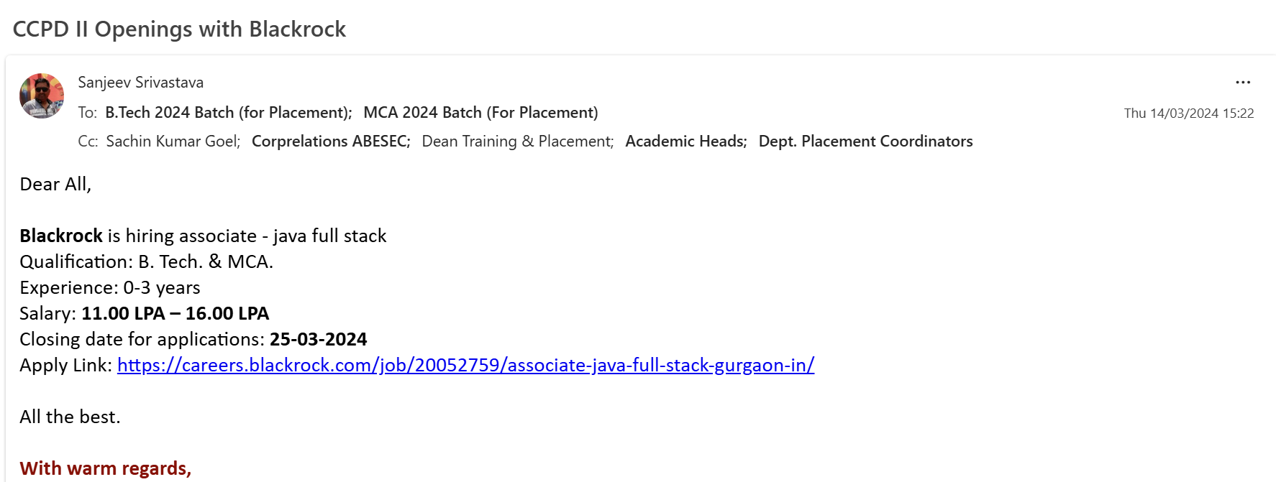
Data from Career Planning & Development :

Slide 14
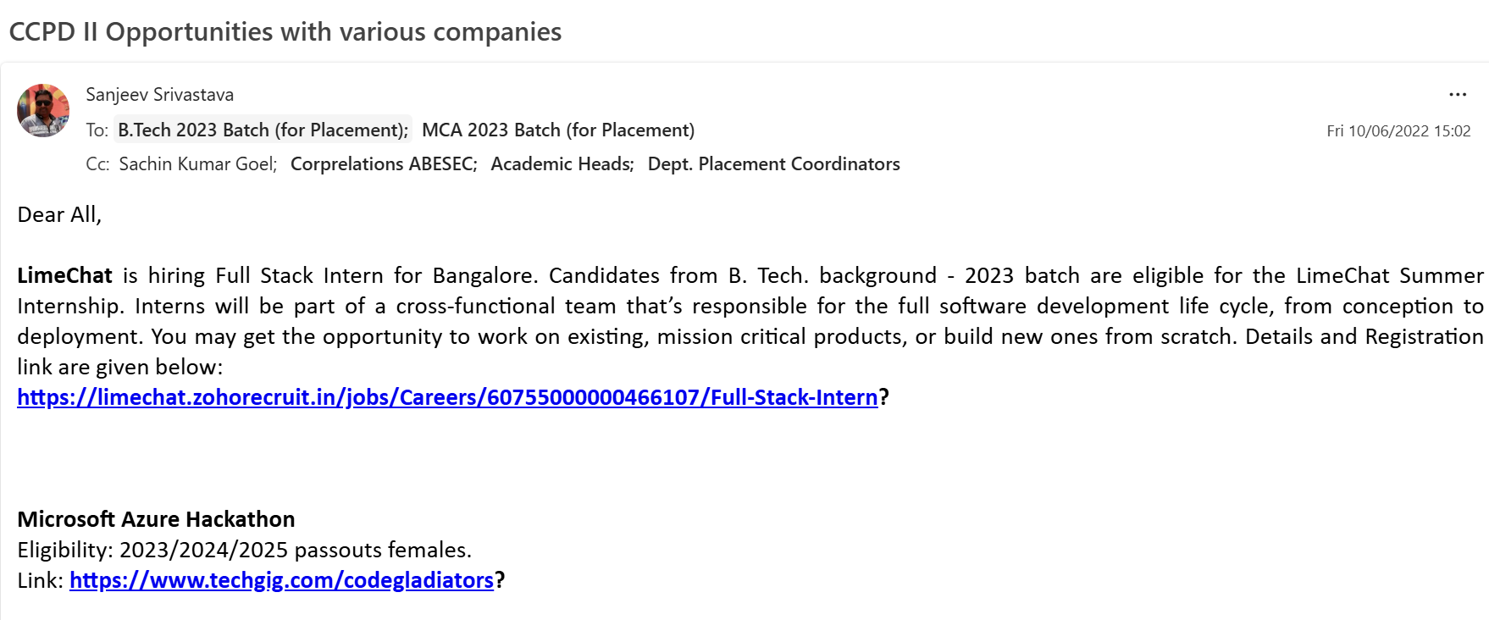
Data from Career Planning & Development :

Slide 15
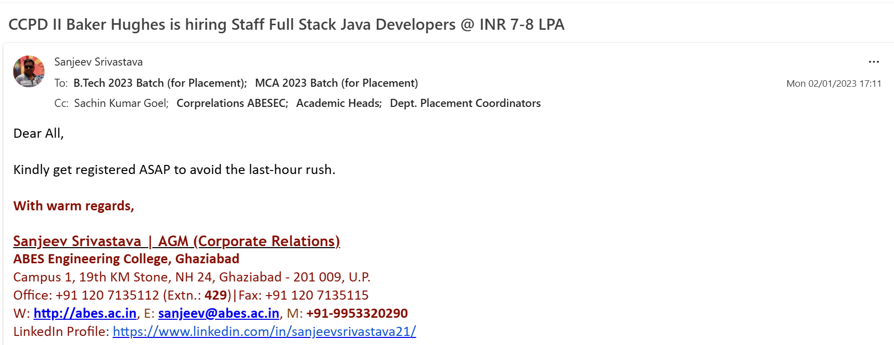
Data from Career Planning & Development :

Slide 16
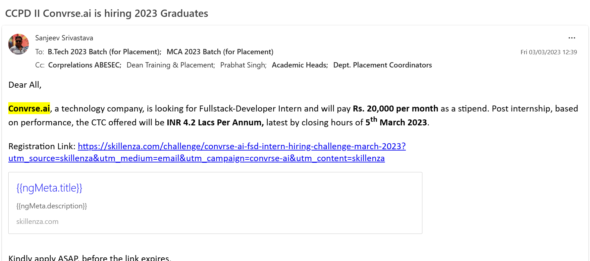
Data from Career Planning & Development :

Slide 17
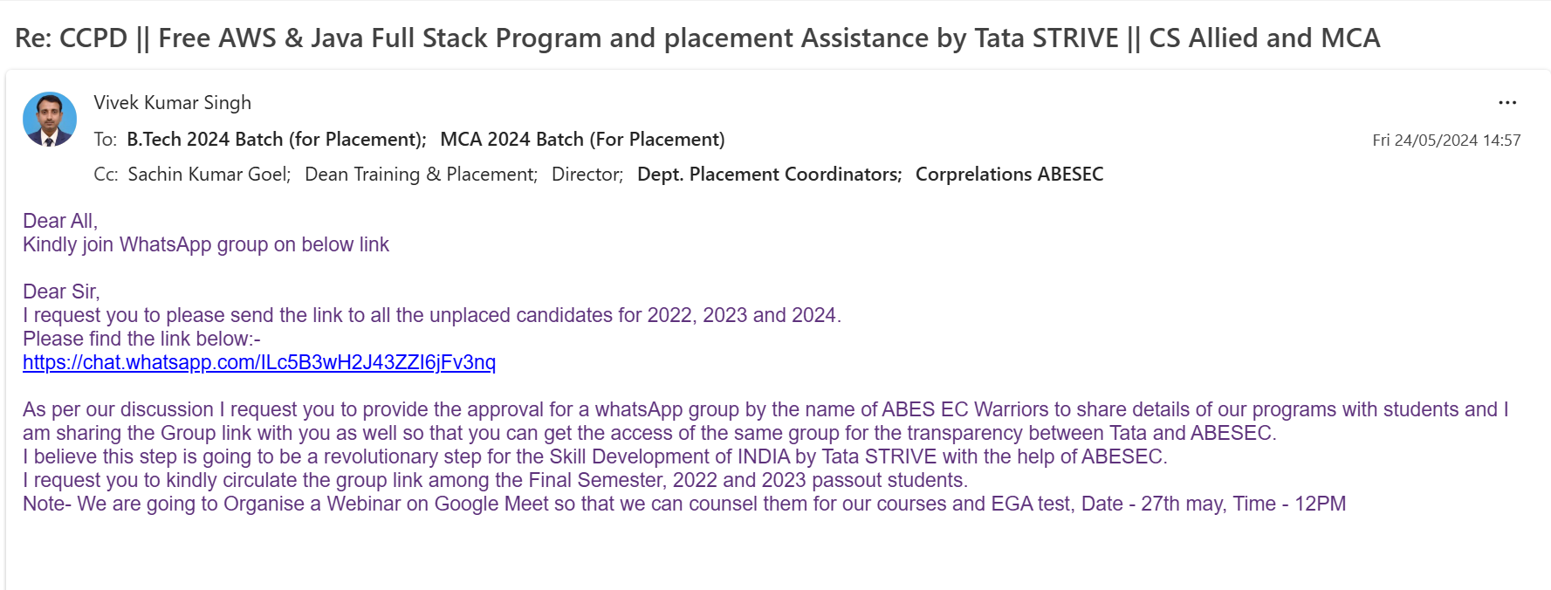
Data from Career Planning & Development :

Slide 18
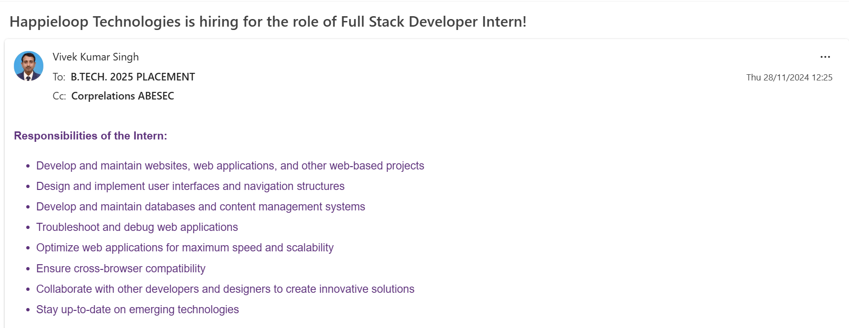
Data from Career Planning & Development :

Slide 19
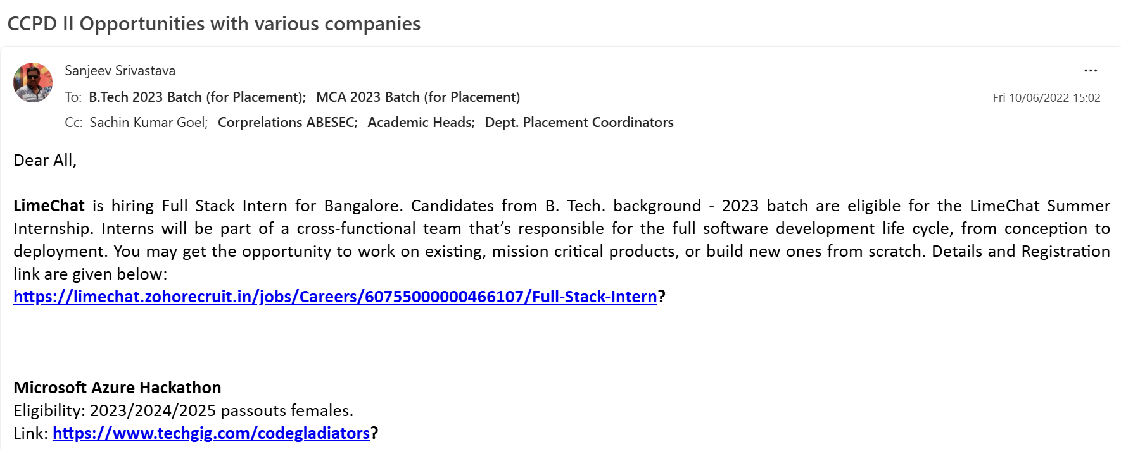
Data from Career Planning & Development :

Slide 20
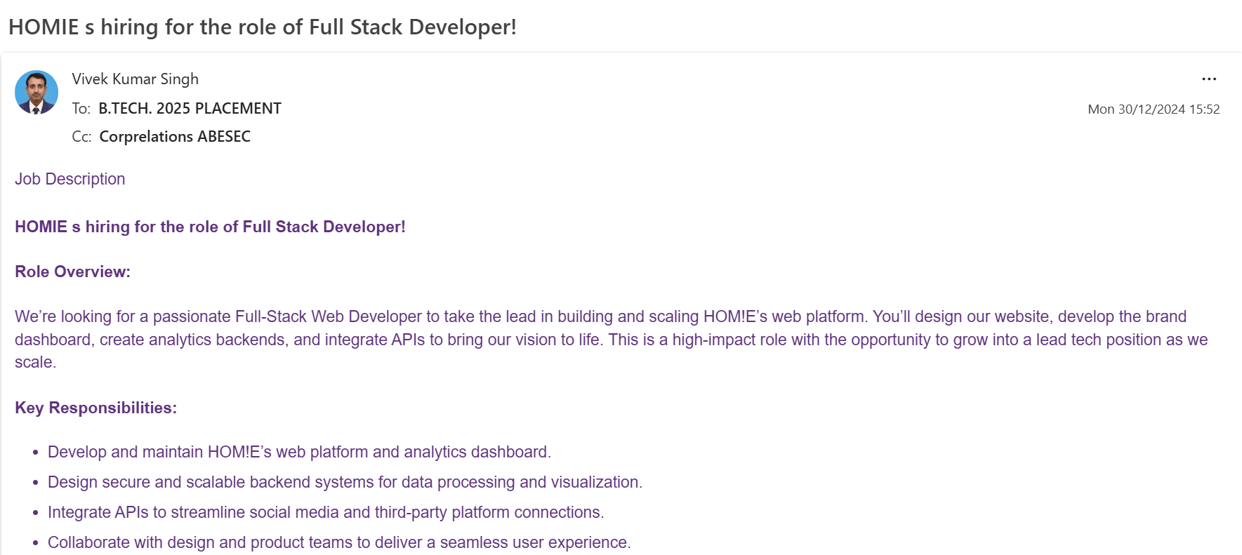
Data from Career Planning & Development :

Slide 21
Git is important, and why it's important
What is Git?
Git is a version control system (VCS).
It helps developers track changes in their code, collaborate with teams, and manage project history.
Originally created by Linus Torvalds (the creator of Linux kernel) in 2005.

Slide 22
Why is Git Important?
🔹 1. Version Tracking
Every change is recorded.
You can roll back to previous versions if something breaks.
Prevents loss of work.
🔹 2. Collaboration
Multiple developers can work on the same project at the same time.
Git merges everyone’s contributions smoothly.
Avoids overwriting code.
🔹 3. Branching and Experimentation
You can create a branch (a separate workspace) to test features/ideas.
If it works → merge into main project.
If not → discard without affecting the main code.

Slide 23
🔹 4. Backup & Remote Repositories
With Git platforms (GitHub, GitLab, Bitbucket), your code is stored remotely.
Provides backup and access from anywhere.
🔹 5. Accountability
Each commit (change) records who made it, when, and why.
Makes tracking bugs and responsibilities easier.
🔹 6. Industry Standard
Almost all software companies expect developers to know Git.
It’s essential for open-source contributions, teamwork, and DevOps workflows.
https://www.youtube.com/watch?v=OHcrb1XroMg

Slide 24
Thank you

